Slide 1

Excello
Music Composition in Excel
Henry Mattinson
University of Cambridge

Slide 2

Who’s Henry?
Final year University of Cambridge Computer Scientist
Musician
Spreadsheet Enthusiast

Slide 3
Contents
Existing Programs
Objectives
Design
Implementation + Demos
Evaluation

Slide 4
Why?

Slide 5
Existing Programs

Slide 6
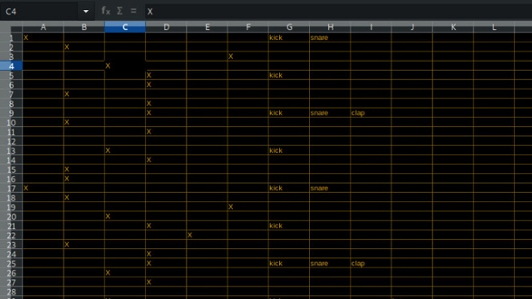


Existing Programs
Spreadsheet Music
#
(
Integrated with spreadsheet
Spreadsheet
E
Abstracts Time
Scalable
Photo: https://hackaday.com/2019/02/02/never-mind-the-sheet-music-heres-spreadsheet-music/

Slide 7
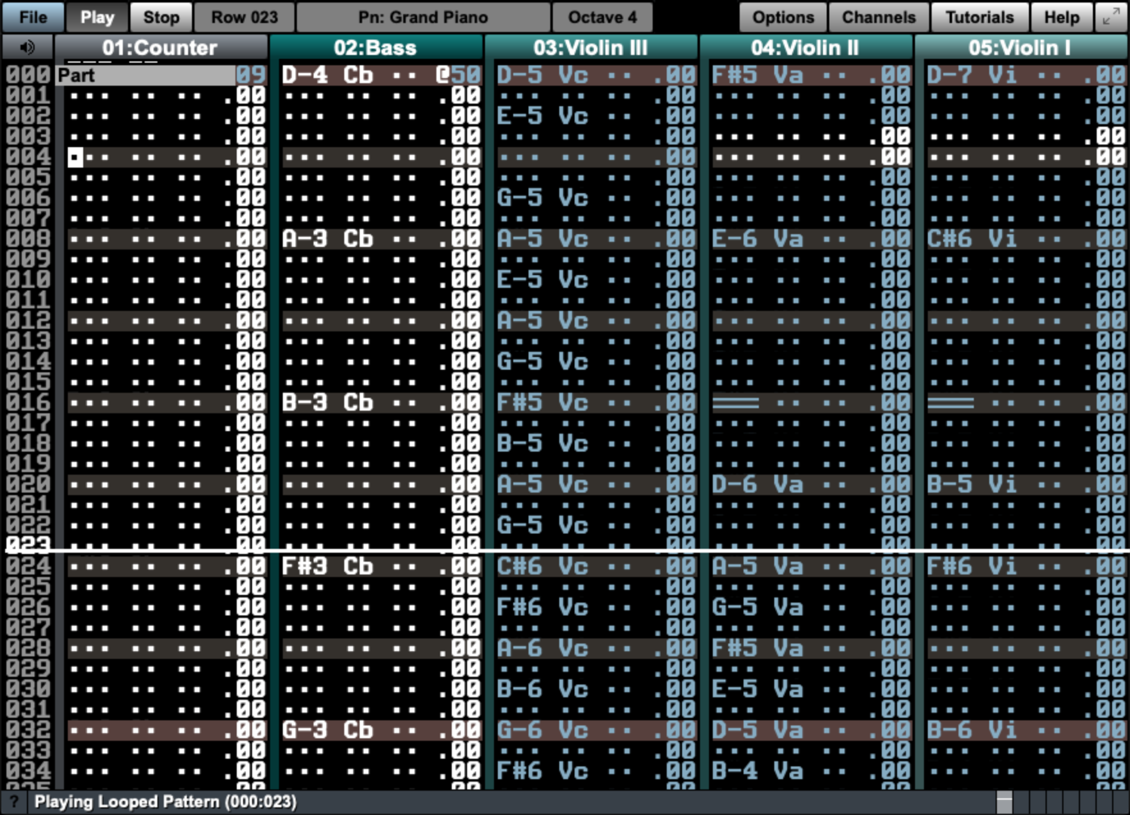

Existing Programs
Manhattan
#
(
Integrated with spreadsheet
Spreadsheet
E
Abstracts Time
Scalable

Slide 8
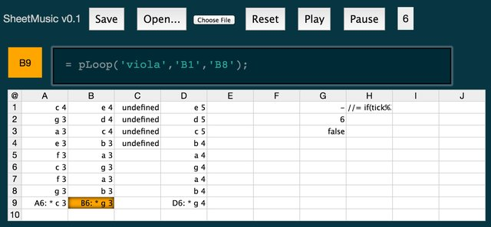
Existing Programs
Sheet Music
#
(
Integrated with spreadsheet
Spreadsheet
E
Abstracts Time
Scalable
Photo: https://www.researchgate.net/publication/307938052_Towards_spreadsheet_tools_for_end-user_music_programming/figures

Slide 9
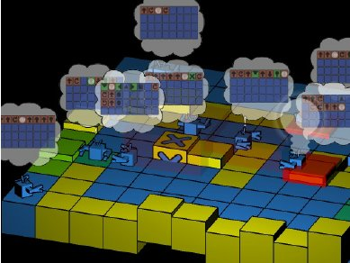
Existing Programs
Al-Jazari
#
(
Integrated with spreadsheet
Spreadsheet
E
Abstracts Time
Scalable
Photo: https://www.researchgate.net/publication/229013989_Texture_Visual_Notation_for_Live_Coding_of_Pattern

Slide 10
Objectives

Slide 11
Objectives
#
Spreadsheet
(
Inclusive to spreadsheet
E
Abstracts Time
Scalable

Slide 12
Design + Implementation

Slide 13
Design + Implementation
Particpatory Design
Initial formative evaluation sessions
21 users
Continued feedback
Outcomes:
Dynamics in cells
Inferred octave
Nested instructions
Toggling button
Continuous dynamics
Automatic stepping
Absolute tempo

Slide 14
Evaluation

Slide 15
Evaluation
MIDI Conversion
Summative Evaluation
19 of the original 21 users
Transcription and composition task
Analysis of participatory design features
Cognitive dimensions of notation questionaire
Comparison with Sibelius

Slide 16
Thank you

Slide 17
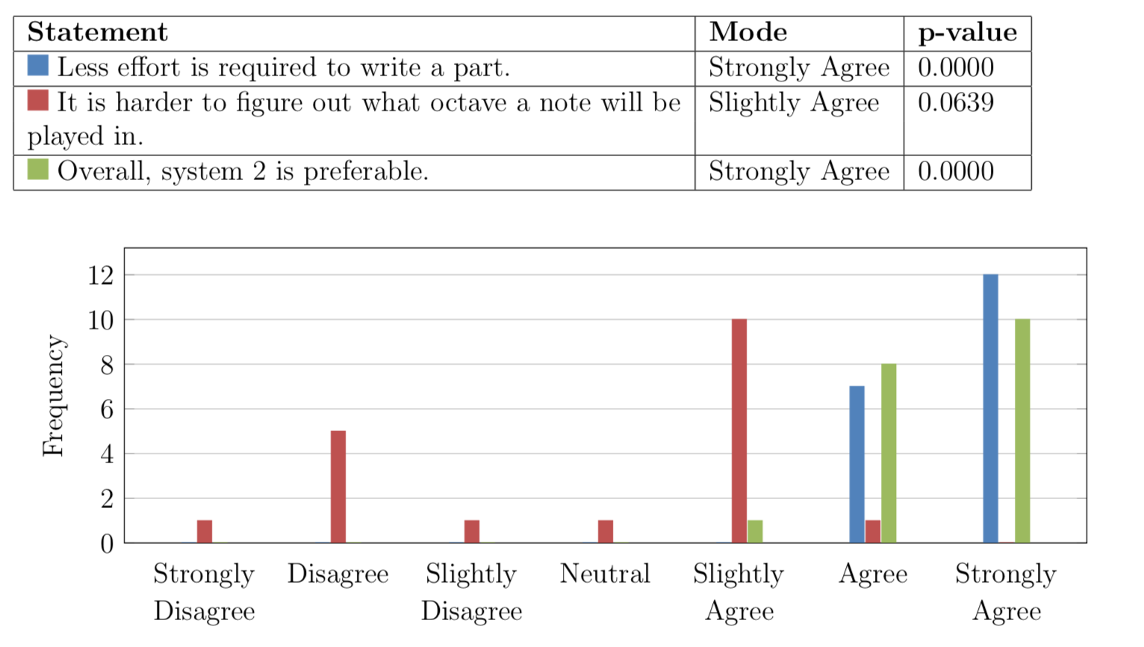
Evaluation
Inferred Octaves

Slide 18
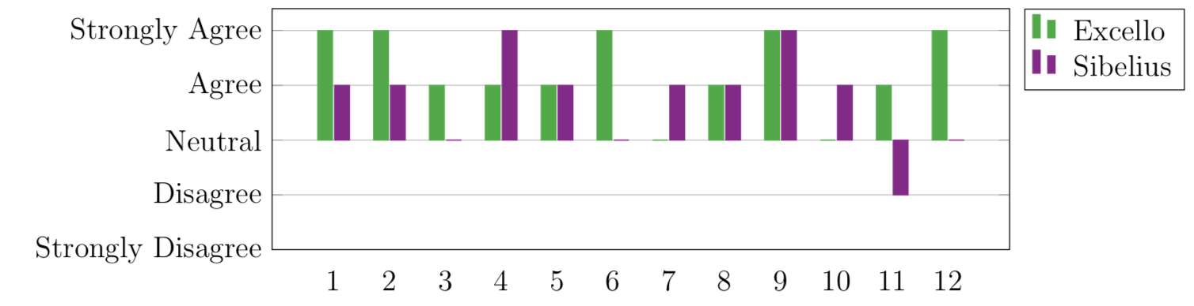
Evaluation
Viscosity Cognitive Dimension
When you need to make changes to previous, work it is easy to make the change

